Slide 1
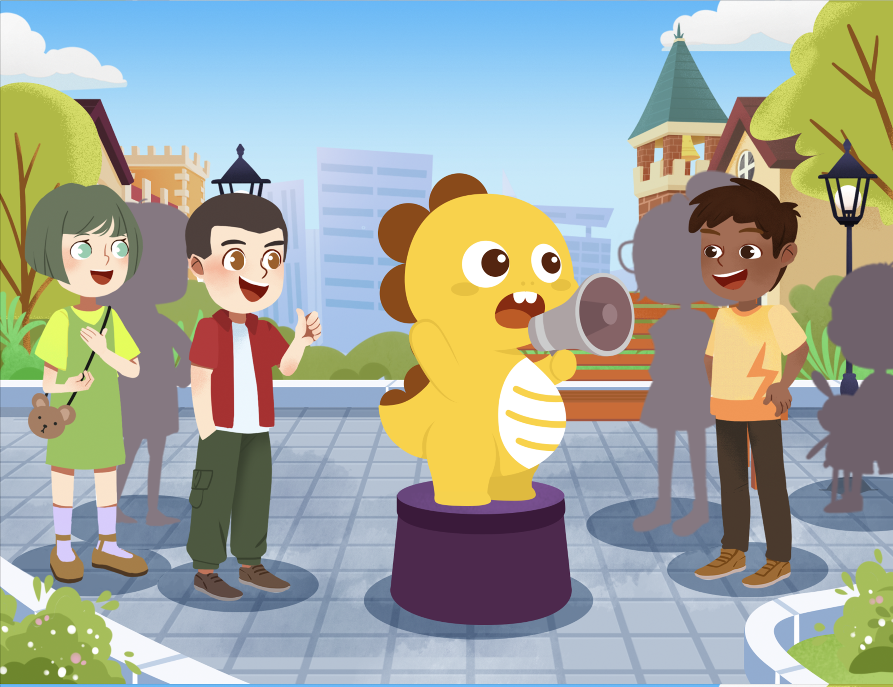
Draft
Not for reuse or redistribution
Persuasive
Level 3
Lesson 8
Slowing Global Warming
Notes:
S may read the text independently or with assistance from T.
S may answer when T asks how many times they practiced their speech, if they used their graphic organizer, and any other questions related to enrichment tasks from Lesson 7.
Note: Enrichment tasks after Lesson 7 included:
Practice using verbal skills while delivering the speech.
Watch a video of the speech and follow along with marked script. Practice delivering the speech again, using the marked scripts.
Use a blank graphic organizer to practice the speech.
Fill in any details you might want to add to a graphic organizer.

Slide 2
Persuasive
Level 3
Draft
Not for reuse or redistribution
Lesson 5
Lesson 7
Content
Skills
Lesson 6
Lesson 8
Recall
Perform!
Notes:
S may read the text independently or with assistance from T.

Slide 3
Today’s Plan for Success
“Slowing Global Warming”
Draft
Not for reuse or redistribution
Review Verbal & Non-verbal Skills
Lesson 8
Develop Ideas
Perform
Perform & Get Feedback
Notes:
S may read the text on screen independently or with assistance from T.

Slide 4
Today’s Class
How can I practice speaking in today’s class?
Include your own ideas about slowing global warming.
Use verbal and non-verbal skills together.
Ask questions about your feedback.
Notes:
S may read the question posed by the character on the left.
S may listen as T responds with the three reminders on the right.

Slide 5
Check-in
Rate the difficulty of the verbal skills from Lesson 3.
1=not difficult 5=difficult
rate
1 2 3 4 5
volume
1 2 3 4 5
pitch
1 2 3 4 5
pausing
1 2 3 4 5
intonation
1 2 3 4 5
Notes:
S may read the text aloud independently or with assistance from T.
S may circle or underline the number that represents how challenging the specific skill was for them, either in Lesson 3 or when they practiced independently.
Note: T may use this check-in as they consider which skills to further practice in the lesson.

Slide 6
Check-in
Rate the difficulty of the verbal skills from Lesson 3.
1=not difficult 5=difficult
eye contact
1 2 3 4 5
audience awareness
1 2 3 4 5
gesture and mime
1 2 3 4 5
body movement
1 2 3 4 5
appearance
1 2 3 4 5
Notes:
S may read the text aloud independently or with assistance from T.
S may circle or underline the number that represents how challenging the specific skill was for them, either in Lesson 3 or when they practiced independently.
Note: T may use this check-in as they consider which skills to further practice in the lesson.

Slide 7
Fourth
Read-through
(Final Rehearsal)
Focus on:
Warming Up
Get your voice ready.
Shake it out.
Practicing
Give your speech, and get teacher feedback.
Give your speech, and rate yourself.
Notes:
S may read the text aloud independently or with assistance from T.

Slide 8
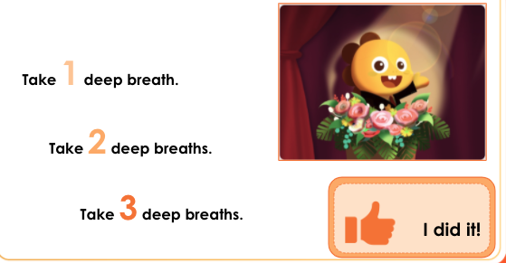
Fourth
Read-through
Question Type: Freematch
Way: Individual
Duration: 10s
Question Tag: Vocabulary
Correct answers:
Answers may vary according to S.
Warming Up
Get your voice ready for pausing, pitch, and intonation.
Sing
“I’m ready!”
Make an animal noise.
Take three deep breaths.
Drag each sentence to the “I did it!” box after completing.
I did it!
Notes:
S may listen as T reminds them of the importance of physically getting ready to deliver a speech.
S may read the text aloud independently or with assistance from T.
S may watch as T demonstrates different ways to warm up before speaking.
Scaffold: S may not want to do all three. Encourage S to choose 1-2 instead.
Note: S does not need to focus on the words on screen, which may be new to them. Instead, S should focus on the action as modeled by T.
Extension: S and/or T may share other ways to warm up before speaking.

Slide 9
Fourth
Read-through
Question Type: Freematch
Way: Individual
Duration: 10s
Question Tag: Vocabulary
Correct answers:
Answers may vary according to S.
Warming Up
Shake it out. Get ready for body movement, gestures, and mime!
Jump up and down.
Wiggle your fingers and toes.
Shrug your shoulders.
Drag each sentence to the “I did it!” box after completing.
I did it!
Notes:
S may listen as T reminds them of the importance of physically getting ready to deliver a speech.
S may read the text aloud independently or with assistance from T.
S may watch as T demonstrates different ways to warm up before speaking.
Note: S does not need to focus on the words on screen, which may be new to them. Instead, S should focus on the action as modeled by T.
Extension: S may share other ways they warm up before speaking.

Slide 10
Third
Read-through
Anecdotes & Style
REMEMBER
Practice delivering the speech in a way that makes you feel comfortable and confident.
Change some words!
Add an anecdote!
If you make a mistake in the speech, move on!
Notes:
S may read the text independently or with assistance from T.
S may share an anecdote or any word changes they may have made to feel more comfortable; T may remind S of the work they may have done with “Volunteering” by adding anecdotes or changing wording.

Slide 11
Fourth
Read-through
Final Rehearsals
First Rehearsal: Give your speech, and get teacher feedback.
Second Rehearsal: Give your speech, and rate yourself.
Notes:
S may read the text independently or with T assistance.

Slide 12
Fourth
Read-through
How You’ll Get Feedback
 | 1 Poor | 2 Fair | 3 Good | 4 Very good | 5 Excellent
rate
volume
pitch
pausing
intonation
body language
engagement
Notes:
S may listen to T explain categories and descriptors or revisit examples from the lesson/speech.
Note: explanations for each are as follow.
rate: the speed of speech (how quickly/slowly you speak)
volume: how loud the speaker’s voice is
pitch: emphasis added to content words
pausing: the breaks within and between sentences
intonation: the rise and fall of the voice
body language: the speaker’s use of facial expressions and gestures
engagement: the speaker’s interaction with the audience

Slide 13
First Rehearsal
Give your speech, and get feedback from your teacher.
Notes:
S may read the text aloud independently or with assistance from T.

Slide 14
Non-verbal & Verbal Skills
Choose at least one non-verbal skill and at least one verbal skill to practice with the graphic organizer on the next slide.
NON-
VERBAL SKILLS
VERBAL SKILLS
eye contact
rate
audience awareness
volume
body movement
pitch
gestures and mime
pausing
appearance
intonation
Notes:
S may read the instructions aloud independently or with assistance from T.
S may choose at least one verbal skill and at least one non-verbal skill to practice on the next slide.
Note: T should remember these skills for the next slide.

Slide 15
Retell
Retell as much of the speech as you can using important details from your graphic organizer.
Use the verbal and non-verbal skills you chose on the previous slide.
Introduction
We all know that our air is polluted. There are too many greenhouse gasses that make the earth warmer. This causes...
Supporting Evidence 1
Recycle. If you recycle half of your family’s waste… Drive less. Instead of driving yourself, take...
Notes:
S may use this graphic organizer to help them as they try to recall as much of the speech as they can from memory.
S may be reminded that they completed this same task in previous lessons.
Note: A graphic organizer that includes all text from the speech is included at the end of the lesson, for reference as necessary throughout the lesson.

Slide 16
Retell
Supporting Evidence 2
Eat less beef, lamb, and mutton. Cows, sheep, and goats create… Save electricity. Turn lights and other electrical devices off when you aren’t using them. Use less...
Counterargument | Response
Some argue that we can’t slow down our productivity while we are quickly developing. Why should China... | Well, first, China has far more people than other countries. So, the impact on the environment could be much bigger. Also, China is already proving that...
Conclusion
China has the chance to prove to the world that an economy can grow without harming the environment. We should all be proud… China is one of the world’s leading economies. Let’s also...
Notes:
S may use this graphic organizer to help them as they try to recall as much of the speech as they can from memory.
S may be reminded that they completed a similar task at the end of lesson 2.
Note: A graphic organizer that includes all text from the speech is included at the end of the lesson, for reference as necessary throughout the lesson.

Slide 17
Teacher Feedback
 | 1 Poor | 2 Fair | 3 Good | 4 Very good | 5 Excellent
rate
volume
pitch
pausing
intonation
body language
engagement
Notes:
S may listen to T explain categories and descriptors or revisit examples from the lesson/speech.
S may listen as T rates the speech and marks different scores.
Extension: S and T may discuss strategies for improvement.
Note: Explanations for each are as follow.
rate: the speed of speech (how quickly/slowly you speak)
volume: how loud the speaker’s voice is
pitch: emphasis added to content words
pausing: the breaks within and between sentences
intonation: the rise and fall of the voice
body language: the speaker’s use of facial expressions and gestures
engagement: the speaker’s interaction with the audience

Slide 18
Second Rehearsal
Give your speech, and rate your own delivery.
Notes:
S may read the text aloud independently or with assistance from T.

Slide 19
Retell
Retell as much of the speech as you can using important details from your graphic organizer.
Use the verbal and non-verbal skills you’ve been practicing.
Introduction
We all know that our air is polluted. There are too many greenhouse gasses that make the earth warmer. This causes...
Supporting Evidence 1
Recycle. If you recycle half of your family’s waste… Drive less. Instead of driving yourself, take...
Notes:
S may use this graphic organizer to help them as they try to recall as much of the speech as they can from memory.
S may be reminded that they completed this same task at the end of lesson 2.
Note: A graphic organizer that includes all text from the speech is included at the end of the lesson, for reference as necessary throughout the lesson.

Slide 20
Retell
Supporting Evidence 2
Eat less beef, lamb, and mutton. Cows, sheep, and goats create… Save electricity. Turn lights and other electrical devices off when you aren’t using them. Use less...
Counterargument | Response
Some argue that we can’t slow down our productivity while we are quickly developing. Why should China... | Well, first, China has far more people than other countries. So, the impact on the environment could be much bigger. Also, China is already proving that...
Conclusion
China has the chance to prove to the world that an economy can grow without harming the environment. We should all be proud… China is one of the world’s leading economies. Let’s also...
Notes:
S may use this graphic organizer to help them as they try to recall as much of the speech as they can from memory.
S may be reminded that they completed a similar task at the end of lesson 2.
Note: A graphic organizer that includes all text from the speech is included at the end of the lesson, for reference as necessary throughout the lesson.

Slide 21
Self-feedback
 | 1 Poor | 2 Fair | 3 Good | 4 Very good | 5 Excellent
rate
volume
pitch
pausing
intonation
body language
engagement
Notes:
S may listen to T explain categories and descriptors or revisit examples from the lesson/speech.
S may rate their own delivery of the speech and mark different scores.
Extension: S and T may discuss strategies for improvement.
Note: Explanations for each are as follow.
rate: the speed of speech (how quickly/slowly you speak)
volume: how loud the speaker’s voice is
pitch: emphasis added to content words
pausing: the breaks within and between sentences
intonation: the rise and fall of the voice
body language: the speaker’s use of facial expressions and gestures
engagement: the speaker’s interaction with the audience

Slide 22
Time to Present!
Notes:
S may read the text aloud independently or with assistance from T.

Slide 23
Your Skills
Wow!
You know a lot!
Verbal Skills
Non-verbal Skills
rate
volume
pitch
pausing
intonation
eye contact
audience awareness
body movement
gestures & mime
appearance
Notes:
S may review what the skills mean and why they are important with assistance from T.
S may identify mental and physical strategies they can use to feel comfortable before delivering the speech (e.g., doing warm-ups) during their delivery of the speech (e.g., pausing, slowing down), and after delivering the speech (studying their own speech delivery).

Slide 24
Ready?
Take a few deep breaths, and loosen up.
Pause before you speak, and review the first line in your head.
Remember to speak at an appropriate pace, and avoid filler words!
Remember that your teacher may have some questions for you after feedback.
Notes:
S may read the text aloud independently or with assistance from T and go through the motions of each suggested step.

Slide 25
Where to Start?
There are three options for where to start giving the speech today. Your goal is Option 1. Start there or with another option and work your way up the list.
1. Recall the speech from memory without using any notes.
2. Use your graphic organizer.
3. Use the upcoming slides for reference.
Notes:
S may read the text on the slide with or without assistance from T.
S may pick one of the three options.
Note: Option 1 or 2 is strongly encouraged. T may encourage S to try option 1 or 2 first.
S may deliver the speech using one of the three options.
Extension:
S may acknowledge that if they choose Option 3 for the first speech delivery, they will be expected to try option 2 the second time.
S may acknowledge that if they choose Option 2 for the first speech delivery, they will be expected to try option 1 the second time.
S may acknowledge that if they choose Option 1 for the first speech delivery, they will have opportunities to get feedback and improve in subsequent deliveries.

Slide 26
Option 1
Recall the speech from memory without using any notes. You can do it!
Notes:
S may recall the speech from memory without using any notes.

Slide 27
Option 2
Use the graphic organizer as you retell the speech.
Introduction
We all know that our air is polluted. There are too many greenhouse gasses that make the earth warmer. This causes...
Supporting Evidence 1
Recycle. If you recycle half of your family’s waste… Drive less. Instead of driving yourself, take...
Notes:
S may use this graphic organizer to help them as they try to recall as much of the speech as they can from memory.
S may be reminded that they completed this same task at the end of lesson 2.
Note: A graphic organizer that includes all text from the speech is included at the end of the lesson, for reference as necessary throughout the lesson.

Slide 28
Option 2
Supporting Evidence 2
Eat less beef, lamb, and mutton. Cows, sheep, and goats create… Save electricity. Turn lights and other electrical devices off when you aren’t using them. Use less...
Counterargument | Response
Some argue that we can’t slow down our productivity while we are quickly developing. Why should China... | Well, first, China has far more people than other countries. So, the impact on the environment could be much bigger. Also, China is already proving that...
Conclusion
China has the chance to prove to the world that an economy can grow without harming the environment. We should all be proud… China is one of the world’s leading economies. Let’s also...
Notes:
S may use this graphic organizer to help them as they try to recall as much of the speech as they can from memory.
S may be reminded that they completed a similar task at the end of lesson 2.
Note: A graphic organizer that includes all text from the speech is included at the end of the lesson, for reference as necessary throughout the lesson.

Slide 29
Option 3
Use the upcoming slides for reference.
Only choose this option if you really cannot do Option 1 or 2.
Notes:
S may read the text aloud independently or with assistance from T.

Slide 30
Slowing Global Warming
Speech
1/3
We all know that our air is polluted. There are too many greenhouse gasses that make the Earth warmer. This causes terrible storms, melting glaciers, drought, and other problems. But even you and I can help.
Recycle. If you recycle half of your family’s waste, you can save thousands of kilograms of carbon dioxide per year.
Drive less. Instead of driving yourself, take a bus or subway.
Notes:
S may use the text as they deliver their speech.
S may acknowledge the paragraphs of the speech/graphic organizer based on the icon.

Slide 31
Slowing Global Warming
Speech
2/3
Save electricity. Turn lights and other electrical devices off when you aren’t using them. Use less heating and air conditioning.
Eat less beef, lamb, and mutton. Cows, sheep, and goats create a lot of methane. Instead, consider eating different meats or vegetables.
Some argue that we can’t slow down our productivity while we are quickly developing. Why should China, as a country with a fast-growing economy, slow its growth when well-developed countries did not as they grew? Well, first, China has far more people than other countries. So, the impact on the environment could be much bigger. Also, China is already proving that by using new, clean sources of energy, we can grow quickly and protect the environment at the same time.
Notes:
S may use the text as they deliver their speech.
S may acknowledge the paragraphs of the speech/graphic organizer based on the icon.

Slide 32
Slowing Global Warming
Speech
3/3
China has the chance to prove to the world that an economy can grow without harming the environment. We should all be proud of what our country can do, and all of us should do our part to help.
China is one of the world’s leading economies. Let’s also lead the world in protecting the environment!
Notes:
S may use the text as they deliver their speech.
S may acknowledge the paragraphs of the speech/graphic organizer based on the icon.

Slide 33
Feedback Time
Notes:
S may read the text aloud independently or with assistance from T.

Slide 34
Feedback
 | 1 Poor | 2 Fair | 3 Good | 4 Very good | 5 Excellent
rate
volume
pitch
pausing
intonation
body language
engagement
Notes:
S may listen to T explain categories and descriptors or revisit examples from the lesson/speech.
Note: Explanations for each are as follow.
rate: the speed of speech (how quickly/slowly you speak)
volume: how loud the speaker’s voice is
pitch: emphasis added to content words
pausing: the breaks within and between sentences
intonation: the rise and fall of the voice
body language: the speaker’s use of facial expressions and gestures
engagement: the speaker’s interaction with the audience

Slide 35
Q&A
Answering Questions
1
Tell me more about...
Now it’s your teacher’s turn to ask you a couple of questions.
Use the strategies you practiced in the previous lesson to answer them.
2
Can you give me an example of…?
Notes:
S may read text independently or with T assistance.
S may respond to T questions that begin with “Tell me more about…” and “Can you give me an example of…?”
S may be reminded that they anticipated many questions in the previous lesson.

Slide 36
Time to Present (again)!
Notes:
S may read the text aloud independently or with assistance from T.
S may revisit the options from slides 21-28, including 3 options for speech delivery and the feedback rubric.

Slide 37
Graphic Organizer (full text)
Introduction
We all know that our air is polluted. There are too many greenhouse gasses that make the Earth warmer. This causes terrible storms, melting glaciers, drought, and other problems. But even you and I can help.
Supporting Evidence 1
Recycle. If you recycle half your family’s waste, you can save thousands of kilograms of carbon dioxide per year. Drive less. Instead of driving yourself, take a bus or subway.
Notes:
S may reference this completed graphic organizer (along with slides 38 and 39) as necessary throughout the lesson.

Slide 38
Graphic Organizer (full text)
Supporting Evidence 2
Eat less beef, lamb, and mutton. Cows, sheep, and goats create a lot of methane. Instead, consider eating different meats or vegetables. Save electricity. Turn lights and other electrical devices off when you aren’t using them. Use less heating and air conditioning.
Counterargument | Response
Some argue that we can’t slow down our productivity while we are quickly developing. Why should China, as a country with a fast-growing economy, slow its growth when well-developed countries did not as they grew? | Well, first, China has far more people than other countries. So, the impact on the environment could be much bigger. Also, China is already proving that by using new, clean sources of energy, we can grow quickly and protect the environment at the same time.
Notes:
S may reference this completed graphic organizer (along with slides 37 and 39) as necessary throughout the lesson.

Slide 39
Graphic Organizer (full text)
Conclusion
China has the chance to prove to the world that an economy can grow without harming the environment. We should all be proud of what our country can do, and all of us should do our part to help. China is one of the world’s leading economies. Let’s also lead the world in protecting the environment!
Notes:
S may reference this completed graphic organizer (along with slides 37 and 38) as necessary throughout the lesson.

Slide 41
Extension Option 1
Free Talk
If you could write and deliver your own persuasive speech, what would it be about and why?
Look at the graphic organizer. Where would you add information and evidence to make your argument stronger or more persuasive?
Notes:
S may answer questions on the screen or asked by T. Answers may vary.
Extension: S may frame their hypothetical speech based on the structure of “Slowing Global Warming” (e.g., Introduction, Supporting Evidence 1, Supporting Evidence 2, Counterargument/Response to counterargument, Conclusion).

Slide 42
Extension
Option 2
Impromptu
Try giving another persuasive speech that supports a different point of view. Use the phrases you learned!
Counterargument and Response
Point of view
Supporting evidence
Conclusion
I think that...
I think this because...
Some people may say…, but...
So, that’s why I think that...
Notes:
S may try to give an impromptu speech using the four-step outline below. Impromptu speeches may vary.

Slide 43
Extension
Option 3
Share Two
Pick at least two topics to share with your teacher.
Something I feel more confident about now
A skill I practiced today
Who I’m going to perform the speech for now
Questions about persuasive speeches
Notes:
S may answer questions on the screen or asked by T. Answers may vary.
Extension: After responding to the free talk questions, S may revisit the completed graphic organizer on slides 30-31 and suggest areas to add more details in each of the five paragraphs (six sections of graphic organizer). S may deliver the speech again with their additions and reference rubrics as necessary.

Slide 44
Enrichment
Practice your speech again using your verbal and non-verbal skills. Record your KTV performance.
Deliver the speech to your family or friends, and have them fill out the feedback form.
Extension—Try it!
Try giving another persuasive speech that supports a different point of view. Use the phrases you learned!
Try using your graphic organizer to add additional details to the speech to make it even more persuasive. Practice delivering the new and improved speech!
Notes:
S may read the enrichment slide independently or with assistance from T.

Slide 45
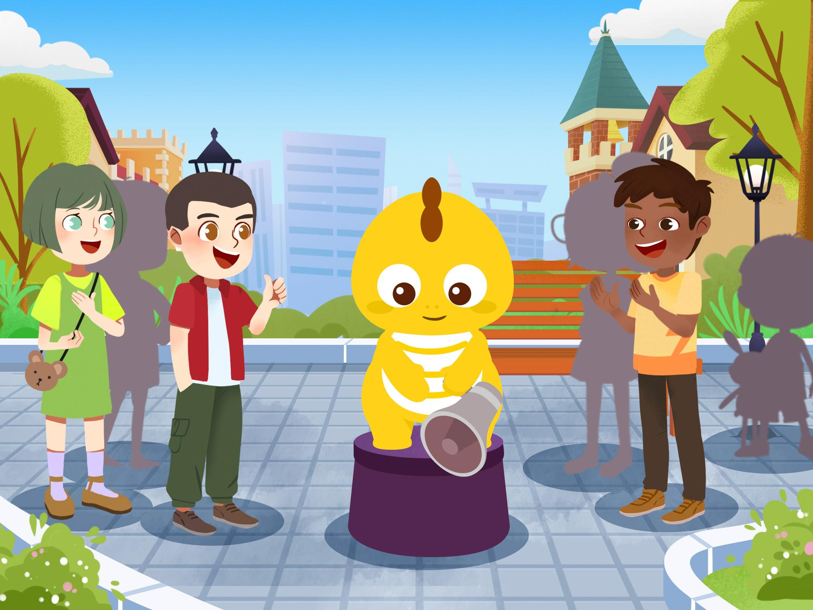
Goodbye!
Goodbye!

